Slide 1
Amazon Product Monitor and Recommendation
Yefei Wang

Slide 2

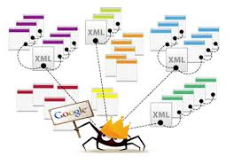

Introduction to “the 12-year-old”
Automatically search amazon products
Get the best discounts
Automatically send them over to you in email

Slide 3
Contents
Architecture
Product Crawler Service
Recommendation Service
User Subscription Service
Design Choice
Inter-service Communication
Data Storage
Subscription Push/Pull
Demo
Sample Email
Terminal Output

Slide 4
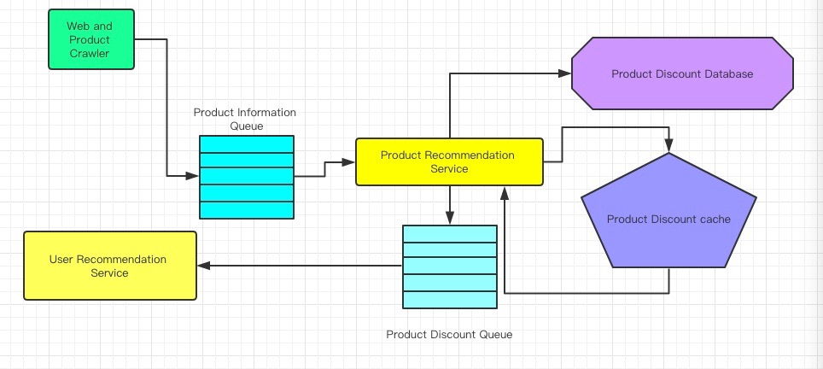
Architecture
Keywords: Spring boot, RabbitMQ, MySQL, MongoDB, Redis, Email, REST

Slide 5

Architecture - Product Crawler Service
Input: Feed file
Output: Crawled results
Design:
Anti-robot
Proxy list
Re-try mechanism
Price detection
Real design: multiple expected price-css
For demo: randomize price
Threading
Single threaded for each instance
Many instance will run together

Slide 6

Architecture - Recommendation Service
Input: Feed file from crawler service
Output: Ad information
Name, price, thumbnail, etc.
Design:
SQL to save all product information
Redis for caching and de-duplication
Message queue for scalable communication

Slide 7

Architecture - User Subscription System
Input: Discounted products
Input: User subscription
Output: Recommendation email
Design:
Only top 100 results for everybody
Top K results to each person
Two implementations
SQL based
Read top K products from database
Message based
Read top K products from messages

Slide 8
Design Choice - Communication
Message Queue:
Scalability
Independent of producer/consumer
High capacity
Can be setup anywhere
RabbitMQ Implementation:
Fame
A.k.a. Stackoverflow support

Slide 9
Design Choice - Data Storage
MySQL:
Ease to sort
Hard to integrate in Springboot
List maintenance against MongoDB
Used to store product information
Redis Cache:
In-memory access
Faaaaaaast
Unreliable
Used to de-duplication incoming product information
MongoDB:
Key-value pair
Eventually consistent
Used to store user subscription

Slide 10
Design Choice - Subscription Push/Pull
Push
Automated email to all users
REST+automation
TODO: encryption of URL
Pull
Email on demand
REST
TODO: display HTML to front end

Slide 11
Demo
Question?

